Slide 1
Erasmus+
Virtual Exchange
INTERCULTURAL LEARNING EXPERIENCES

Slide 2
Erasmus+ Virtual Exchange in a Nutshell
An innovative way for young people to engage in intercultural experiences online
Expanding the reach and scope of the Erasmus+ programme
Goal to foster mutual understanding and skills development
Target of 25,000 youth in 2018-2020
Implemented by a consortium
Notes:
Erasmus + Virtual Exchange is an innovative pilot project established by the European Commission.
It was launched in 2018, with the overall aim to allow as many young people as possible to benefit from a meaningful intercultural learning experience online. They can do this as part of their formal or informal education. The project is meant to expand the reach of Erasmus+ programme through Virtual Exchange, as a complement to physical exchange programmes.
The project’s objectives are twofold: On the one hand, it is about fostering mutual understanding and dialogue. On the other, it is about promoting the development of skills. Equipping young people with the 21st century skills that they need to succeed in today’s globalising world - such as critical thinking, intercultural communication, empathy, media and digital literacy.
During the pilot phase of the project between 2018-2020, the aim is to reach 25.000 participants, with a view to scale the project up in the future, based on the lessons-learned. (The expansion is expected both in terms of numbers and countries involved).
The project is being implemented by a consortium of 8 organisations.

Slide 3
Erasmus+
Virtual Exchange
Rationale for initiative
Politics
Paris Declaration
European Neighbourhood Policy
Media literacy against fake news
Education
Erasmus +
Internationalisation
Digitalisation
Notes:
The creation of Erasmus+ Virtual Exchange project was linked to Educational and Political objectives.
Firstly, on the Educational aspect, the project aims to:
- Expand and enrich the Erasmus+ Programme, offering a complement to physical mobility.
The reach of virtual exchange is unlimited and can bring together an extraordinary number of people. In a nutshell, with Erasmus+ Virtual Exchange, the accessibility to cross-cultural experiences is much higher and the barriers to engage are much lower. You can participate without leaving your bedroom!
- Internationalise the work of High Education Institutions and Youth Organisations.
- Promote the use of technologies in education and youth work.
Secondly, on the Political aspect, the project aims to:
Support values of freedom, tolerance and non-discrimination through education. Following the conclusions of the Paris Declaration (2015).
Enhance cooperation relations with Southern Mediterranean countries, supporting the EU Neighbourhood Policy.
Mitigate the negative effects caused by the rise of fake news, enhancing critical thinking and media literacy.

Slide 4
What is Virtual Exchange?
People-to-people real time dialogue
Interactions are facilitated to ensure they are meaningful
A virtual exchange is a sustained designed pedagogical process
It is technology-enabled
Notes:
It is important to understand what Virtual Exchange is and what it is not. Virtual Exchange is distinct from regular online educational programmes, and has a several defining components:
First, it is people to people, which means that the focus is primarily on genuine, personal and real-time interactions between young people as the core of the exchange and learning.
Second, these interactions are facilitated, which means that they are supported by trained facilitators or educators, to ensure they are meaningful, constructive and reach the intended learning outcomes.
Third, a virtual exchange is sustained over time. It is more than just a one-off meeting, it is a designed pedagogical process that participants go through.
And finally, it is technology enabled, using the broad reach of new media technologies to bring geographically distant people together.
It is therefore different from other forms of online learning which are focused more on content, such as MOOCs. And it is not like social media or online interaction which are unstructured and unmoderated. (It should be seen as a pedagogical approach).

Slide 5
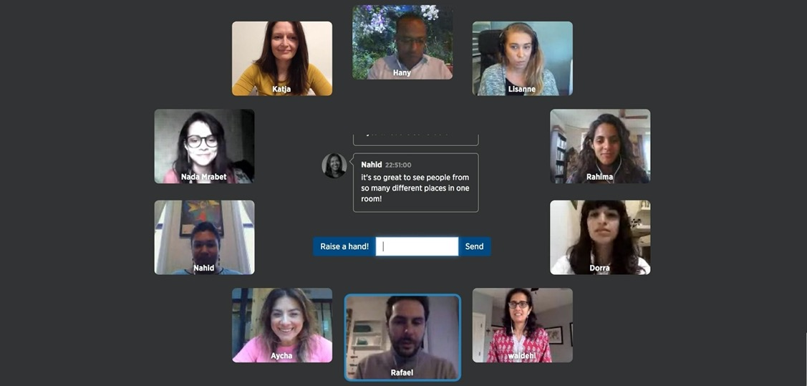
Notes:
On this slide, you can see what a Virtual Exchange looks like in practice. This the main video-conferencing Exchange platform used in the context of the project, which was designed specifically for intercultural dialogue. (The round-table design allows for people to feel like they are in a room together, and the talking-stick methodology is used to ensure young people can be heard, listen and learn from each other. The platform offers several other features to allow the participants to go deeper into the dialogue and exchange, in a fun learning environment).

Slide 6
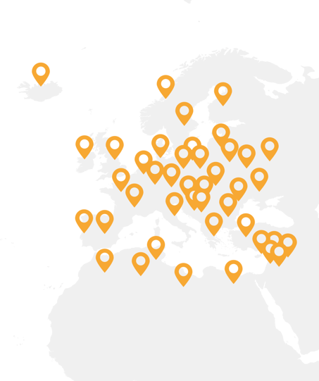
Target audiences
Exchange activities are open to any young person aged 18-30 residing in Erasmus+ programme countries and the Southern Mediterranean
The project also targets
Higher education professors
University managers/administrators
Educators
Youth workers
Notes:
The project offers different models of exchange activities, open to any young person aged between 18 and 30, living in Europe and the Southern Mediterranean. However, the project also aims to offer opportunities and develop partnerships with a broader audience:
Higher Education Institutions (e.g. professors, university managers and administrators), which can integrate virtual learning in their educational programmes, and
Youth Organisations (youth workers), which can offer different project activities as opportunities for their members, or develop a youth project with other partnering organisations.

Slide 7
What makes it unique
Scalability and inclusivity
Experiential learning
Community of trust
Learner-led approach
Notes:
This brings the question: what is the value of the project, why is it unique?
The key power of the project lies in its potential to reach larger numbers and its inclusive character. Traditional physical exchange programmes are not accessible to many young people, for a variety of reasons. This projects brings intercultural learning opportunities to young who would otherwise not benefit from such an experience, due to financial, practical, security, visa reasons, or simply apprehension/fear of leaving their country.
The learning is experiential, young people are not just learning about things but in fact experiencing HOW to be comfortable and to collaborate with people with different ideas and backgrounds. This means they build empathy and other intercultural competencies while engaging constructively with difference.
It also builds a community of trust – a space where young people learn to express their own view but also to listen. Where they feel heard and respected. And where they develop the confidence to think critically about their own perspectives.
And finally, a learner-led approach is used. Participants are empowered to lead the dialogue and co-create knowledge, based on their own experiences.

Slide 8
Exchange topics and themes
Current events
Religion
Social Culture
Racism
Gender Equality
Media
Environmental issues
Notes:
I wide variety of topics are addressed in the different activities offered by the project, related to current events and political and social issues that matter to youth.
Topics include: religion, gender equality, social inclusion, migration, human rights, current events, environmental issues...

Slide 9
What Erasmus+ Virtual Exchange offers
For Youth
Develop intercultural and interpersonal competencies
Learn new employability skills
Build personal relationships across borders
Feel empowered to become an active citizen in a global context
Foster greater interest in Erasmus mobility programmes
Notes:
Offering cross-cultural experiences to as many young people as possible can change people’s attitudes towards others from different cultures. The project promotes values and interpersonal competencies such as: tolerance, empathy, and critical thinking. Being exposed to other people’s opinions encourages social integration and tolerance. Other soft skills, such as the practice of foreign languages and intercultural teamwork, also contribute to enhance participant’s employability skills.

Slide 10
What Erasmus+ Virtual Exchange offers
For Educators and Youth Workers
Offer professional development and learning opportunities
Enrich existing programmes through an innovative approach
Bring an international dimension to curricula or programmes
Collaborate and build partnerships with other institutions
Notes:
Erasmus+ Virtual Exchange promotes cross-national partnerships amongst institutions, building bridges amongst regions. The project also contributes to modernising and internationalising university programmes.

Slide 11
Activities
Different models of exchanges for youth
Varying duration, thematic scope and learning outcomes
Training for educators and youth workers
Means of engagement
Young people can sign up directly
Universities, vocational schools or youth organisations can offer these programmes as part of existing curricula or activities
Grassroots exchanges can be designed and implemented by teachers or youth workers themselves
Notes:
In order to satisfy the different needs of the different target audiences, the project implements Virtual Exchange in different ways.
The different models of exchanges for youth vary in terms of duration; some might last one session, while others last 10 weeks. They also vary in thematic scope. And depending on the type of exchange you are involved in, it might be the young people participating, the ones that decide what theme they want to focus in. Therefore, it is learner-centred.The learning outcomes also vary depending on the exchange.
Offering training for educators and youth workers to develop virtual transnational projects with other organisations, is also an important part of Erasmus+ Virtual Exchange project.
In some of the project activities young people can sign up directly but in others, participants have to register, either through a university programme or through a youth organisation.

Slide 12
1. Interactive Open Online Courses
How they work:
Thematic lecture series, small online group dialogue, interactive assignments
A variety of topics
Who can participate:
Eligible young people
Professors/educators/youth workers who want to offer the course(s) to their students or network.
Languages: English, French, Arabic
“I wanted to compare my opinion to other people’s, to find ideas, proposals and solutions on how to manage situations and challenges. Virtual Exchange is revolutionary”
Interactive Open Online Course Participant
Notes:
These courses take place in small online groups. Each week participants join for an intercultural dialogue session and are given an interactive assignments to complete. In other words, they combine intercultural exchange with online learning.
Each course is focused in a different topic or socio-political issue, such as: migration, refugee issues, identity, hate speech, the impact of technology on society, gender equality...(Lecture series).
Any young person interested can apply directly via the project hub.

Slide 13
2. Debate Exchanges
How it works:
Step 1: Team Leader Training
Step 2: Intercultural online debates between teams from the North and South of the Mediterranean on topics of their choice.
Who can participate:
Eligible young people
Languages: English, French, Arabic
“The best part of the exchange is the model adopted for the online debates. It creates a friendly atmosphere and encourages cooperation”
Debate Exchange Participant
Notes:
Step 1 is participating in a Team Leaders Training session on parliamentary debate skills.
After, teams from the North and South of the mediterranean engage in an online debate on topics of their choice.
The session is hosted by a Debate Trainer, and the debates are moderated by the two Team Leaders of each team.
The objective of this activity is to enhance young people's debate skills, such as: building arguments, active listening & rebuttal, organisation of speeches and the use of a specific format for debating.
Participants don’t need to have any experience in debating and no not have to be enrolled in a university programme.

Slide 14
3. Online Facilitated Dialogue
How it works:
Face-to-face meetings with peers from different countries
Meaningful discussions in the presence of trained facilitators.
Who can participate:
Young people individually
Young people through their university or youth organisation
Languages: English, French, Arabic
“This experience changed many things about me and let me be open and curious about other cultures and opinions. You can say whatever you want without being judged”
Interactive Facilitated Dialogue Participant
Notes:
Young people will meet face-to-face with peers from different countries and participate in meaningful discussions in the presence of neutral facilitators.
Provides young people exposure to different perspectives and the key skills needed for a globalised workforce.

Slide 15
4. Training for Transnational Exchange Projects
How it works:
Learn how to develop a grassroots Virtual Exchange Project
Enriches/expands existing programmes
Two or more international partners
Who can participate:
Youth workers
University professors/educators
Languages: English, French, Arabic
“I am not sure what the future holds for me in terms of work, as I am exploring all kinds of avenues right now, but there will definitely be a place for Virtual Exchange”
Transnational Exchange Participant
Notes:
The project offers professional development to individuals from universities and youth organisations who have an idea for a Virtual Exchange and are interested in designing and implementing it together with a partner organisation.

Slide 16
5. Facilitation Training
How it works:
Training in online facilitation tools
Hands-on practice with other trainees
Individualised feedback from trainers
Successful trainees can become an Erasmus+ Virtual Exchange Facilitator
Who can participate:
Anyone
Languages: English, French, Arabic
“This experience has given me so many new perspectives, new skills, and new friends. The community is incredible. Whatever inspiration you see in me is a direct reflection of all that we do to make our world a better place.”
Erin Williams, Senior Facilitator
Notes:
Facilitators are people that have been trained in small online group sessions (through the project), to moderate discussions between young people. They are a neutral party with knowledge on the use of technology, and conflict resolution skills, to guide cross-cultural conversations.
They are not teachers, their objective is to make participants feel comfortable when expressing their own thoughts and ideas.

Slide 17
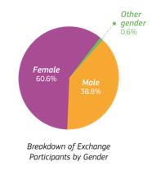
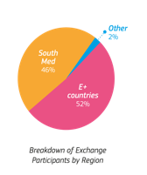
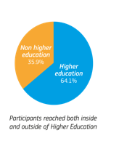
2018 Highlights
8222
Persons engaged in Erasmus+ Virtual Exchange
7450
Young people participated in exchange activities
117
Partnerships created with institutions and organisations
215
Members of the Erasmus+ Virtual Exchange Facilitator community
42
Countries across which connections were built
Notes:
Last year the project engaged 8.222 people.
Over 7.400 young people participated, and nearly 800 people were trained, including: educators and youth workers, team leaders to conduct debate exchanges and facilitators to guide intercultural dialogues. Additionally, 117 partnerships were created across 42 countries, with institutions and organisations that have integrated Virtual Exchange in their courses or projects.
The ratio male-female shows a slight majority of women, which correlates with the ratio of women participating in the Erasmus+ programme and Higher Education programmes.
Around 36% of participants come from non-higher education institutions and our efforts are set to increase this number. More specifically Erasmus+ Virtual Exchange is trying to reach the so called, “hard to reach” youth, meaning those who have less opportunities, come from remote areas, or from refugee or migrant backgrounds.
Finally, we can see that the proportion of participants coming from European and Southern Mediterranean countries is even, therefore, a wide variety of nationalities is assured, which enriches the cultural exchanges and exposure to different cultures.

Slide 18
Impact
87%
67%
Satisfaction among young people
Improved their teamwork and collaborative problem-solving skills
91%
71%
Participants reported improved ability to work in a culturally diverse place
Built meaningful relationships with peers from other countries/regions
78%
62%
Became aware of stereotypes they held about other groups
Improved their digital competencies
Notes:
To understand the impact of the project after its first pilot year, Erasmus+ Virtual Exchange has invested in monitoring and evaluation resources to evaluate the impact of the project.
First of all, it is worth highlighting that there is a very high satisfaction rate amongst young people, which proves the relevance of the different activities.
It is also reported that Virtual Exchange builds employability skills, such as digital competences, the ability of working in culturally diverse places and teamwork.
Overall, statistics demonstrate that Virtual Exchange can produce a real-world impact on young people’s attitudes towards others from different cultures and backgrounds.

Slide 19
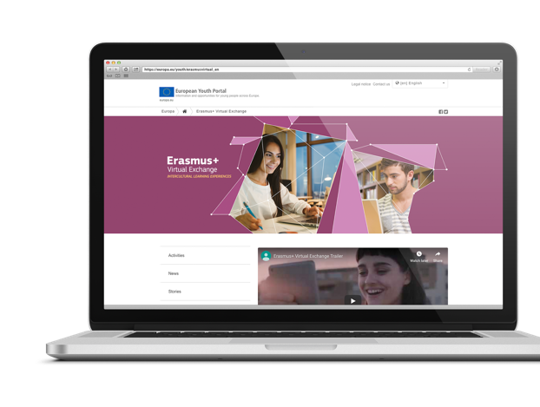
The Hub
europa.eu/youth/erasmusvirtual
Notes:
Find out more about the project and get involved by registering for the different activities on the project’s HUB. You will also find more detailed explanations on the different opportunities and information about the dates of the upcoming trainings, exchanges and debates.
For High Education Institutions and youth organisations that would like to integrate Virtual Exchange in their courses please find the Expression of Interest forms, available for each activity.

Slide 20
Thank You
Find out how you can get involved:
europa.eu/youth/erasmusvirtual

