Slide 1
National and regional priorities in capacity building projects
National Erasmus+ Office in Azerbaijan
Parviz Baghirov
www.erasmusplus.org.az

Slide 2
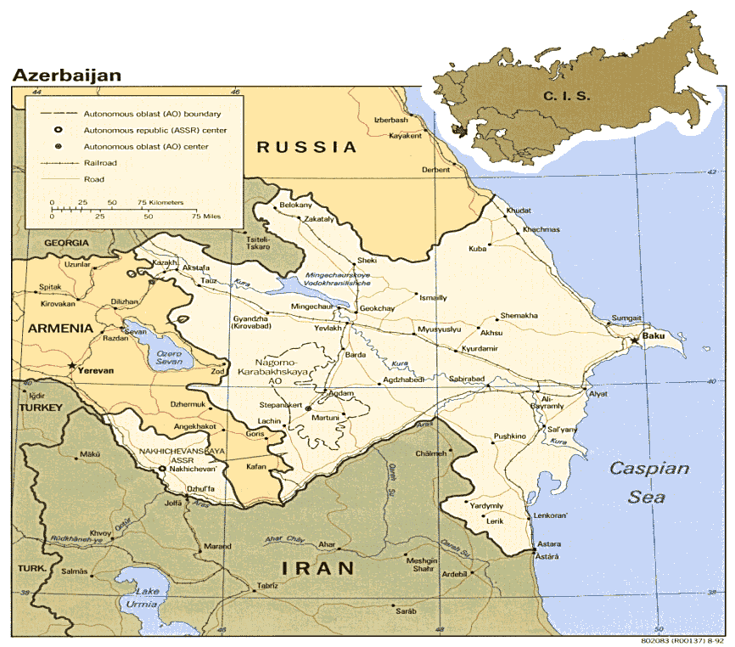
Azərbaycan
The largest country in the South Caucasus region
Population: 9.7 Mio (2013)
Area: 86.600 km²
Capital: Baku
Language: Azerbaijani
Government: Presidential republic

Slide 3
Higher Education System in Azerbaijan
Three cycle degree system (bachelor, master and PhD)
ECTS fully adopted and Diploma supplement issued
Most common model 240+120 credits (4+2 years)
Unified admission exams by a separate government body “State Committee on Student Admission”
Quality assurance mechanisms:
At institutional level – quality assurance departments – self-assessment, surveys, improvement oriented
At national level – Accreditation Unit at Ministry of Education (institutional and programme accreditation)
National Qualification Framework – still in the process of development (possible area of cooperation?)

Slide 4
Higher Education System in Azerbaijan (as of 2014)
Total # of HEIs | 54
Type | Public (38) | Private (16)
Total # Teaching staff | 16 993
Students | BA | MA | PhD | Total
Sum | 126518 | 32 835 | 3 941 | 163 146

Slide 5
Current HE reforms in Azerbaijan
Curriculum Development (Focus on joint degree programmes)
University Autonomy
Development of NQF-based academic standards
Programme accreditation (in regulated professions: medicine, education, law)
Improvement of university quality and management
New financing formula development (student voucher)
Development of Competitive Innovation Funds for HEI

Slide 6
Tempus in Azerbaijan
Bologna process membership since 2005
In Tempus since 1995 (ENI East)
Experience of regional and cross-regional cooperation
45 projects total. In Tempus IV (2008-2013) 30 projects awarded, 22 on-going, 26 institutions involved.
Network of “Tempus-experienced” public and private HEIs

Slide 7
National Erasmus+ Office in Azerbaijan
Overall objective:
“to improve relevance, effectiveness and impact of the Erasmus+ Programme in the country through assistance to European Commission’s services and national authorities in the Erasmus+ programme implementation”
Specific objectives:
Promotion of the programme and assistance to potential applicants
Monitoring of CBHE Projects
Promoting Bologna process and providing information on the implementation of reforms (organization of seminars, conferences, conducting studies)
Engagement in more structured dialogue with educational authorities, involving higher education stakeholders.

Slide 8
AREAS OF COOPERATION UNDER ERASMUS+
Capacity Building in Higher Education (CBHE-former Tempus)
Credit mobility
Joint Degree Master Programme

Slide 9
AZERBAIJAN NATIONAL PRIORITIES UNDER CURRENT ERASMUS+ CBHE CALL
Category A (Curriculum Development – VALID ONLY FOR JOINT PROJECTS!)
Teacher training and Education Science
Life sciences
Physical Sciences
Engineering and engineering trades
Manufacturing and processing
Architecture and building
Agriculture, forestry and fishery
Health
Transport services
Others (Multidisciplinary, Interdisciplinary)

Slide 10
AZERBAIJAN NATIONAL PRIORITIES UNDER CURRENT ERASMUS+ CBHE CALL (CONTINUED)
Category B (Improving quality of Education and teaching – valid for both Joint and SM Projects)
Bologna process
Learning and teaching tools, methodologies and pedagogical approaches including learning outcomes and ICT-based practices Governance, strategic planning and management of HEIs
Category C (Improving management and operation of Higher Education Institutions – valid for both Joint and SM Projects)
Governance, strategic planning and management of HEIs
Internationalisation of higher education institutions
Quality assurance processes and mechanisms
Development of research and innovative capacities (excluding research activities)

Slide 11
AZERBAIJAN NATIONAL PRIORITIES UNDER CURRENT ERASMUS+ CBHE CALL (CONTINUED)
Category D (Developing the Higher Education sector within society at large – valid for both Joint and SM Projects )
University-enterprise cooperation, employability of graduates
Knowledge triangle, innovation (reinforcing links between education, research and business)

Slide 12
REGIONAL PRIORITIES UNDER CURRENT ERASMUS+ CBHE CALL
Region 2
(Eastern Partnership Countries: Armenia, Azerbaijan, Belarus, Georgia, Moldova, Territory of Ukraine as recognized by International Law)
Category A (Curriculum Development – VALID ONLY FOR JOINT PROJECTS!)
Teacher training and Education Science
Social and behavioural science
Law
Physical Sciences
Agriculture, forestry and fishery
Health
Environmental Protection
Credit mobility
Joint Degree Master Programme

Slide 13
REGIONAL PRIORITIES UNDER CURRENT ERASMUS+ CBHE CALL (CONTINUED)
Region 2
(Eastern Partnership Countries: Armenia, Azerbaijan, Belarus, Georgia, Moldova, Territory of Ukraine as recognized by International Law)
Category B (Improving quality of Education and teaching – valid for both Joint and SM Projects)
Learning and teaching tools, methodologies and pedagogical approaches, including learning outcomes and ICT based practices (inter alia, flexible learning paths, blended courses, virtual and real mobilities, practical placements etc)
Category C (Improving management and operation of Higher Education Institutions – valid for both Joint and SM Projects)
Governance, Strategic planning and management of HEIs (including human resource and financial management)
Internationalisation of higher education institutions (including recognition mechanisms and mobility, international relations capacities)
Access to and democratisation of higher education (including the disadvantaged groups of people and regions)

Slide 14
REGIONAL PRIORITIES UNDER CURRENT ERASMUS+ CBHE CALL (CONTINUED)
Region 2
(Eastern Partnership Countries: Armenia, Azerbaijan, Belarus, Georgia, Moldova, Territory of Ukraine as recognized by International Law)
Category D (Developing the Higher Education sector within society at large – valid for both Joint and SM Projects )
University-enterprise cooperation, employability of graduates
Knowledge triangle, innovation (reinforcing links between education, research and business)
International cooperation at regional level (among countries from the same region)
Definition, implementation and monitoring of the reform policies

Slide 15
Azerbaijani HEIs active in international cooperation
Experienced HEIs
Baku State University – 8 Tempus projects
Azerbaijan Languages University – 5 Tempus projects (first Tempus grantholder in Azerbaijan)
Azerbaijan State Oil Academy – 7 Tempus projects
Azerbaijan Technical University – 6 Tempus projects
Azerbaijan Medical University – 6 Tempus project
Khazar University (private) – 7 Tempus projects (Recent project grantholder)
State Universities in Sumgayit, Nakchivan, Ganja and Lenkoran (up to 7 Tempus projects)
Very ambitious HEIs
Azerbaijan Diplomatic Academy
Qafqaz University (private) – 7 Tempus Projects (Recent project grantholder)
Tourism University

Slide 16
Contacts
NEO Azerbaijan www.erasmusplus.org.az
Parviz Baghirov
E-mail: pbaghirov@erasmusplus.org.az pbagirov@gmail.com
Phone: (994 12) 4974865
(994 50) 2038865

Slide 17
Thank you!

